Slide 1
Lesson objective
Title: Plotting simple graphs
Aim:
T o be able to determine the Gradient, Y-intercept and Plot line graphs.
Plan:
Daily review: equations
Intro to linear equations
Plotting graphs

Slide 2
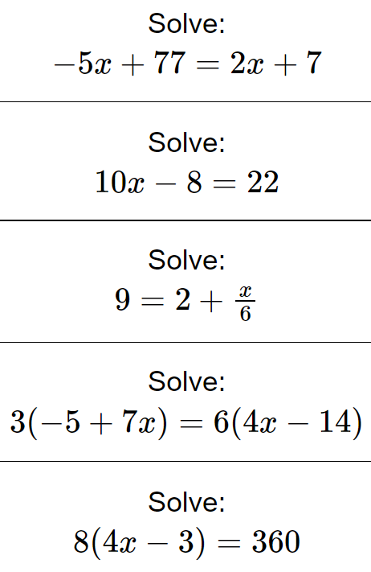
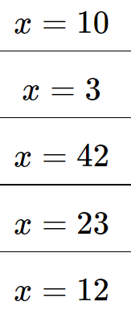

Daily review
$5−3x=4x+12$
$3(2x−1)=4(2x+5)$
$−3\left(2x+1\right)=2(3−4x)$

Slide 3
y = mx + c
Every straight line can be written in this form. To do this the values for m and c must be found.
Where y is a function of x (might see f(x) = mx + c)
c is known as the y-intercept
y = mx + c
m is known as the gradient (or slope) A rate of change
Back to Main Page

Slide 4
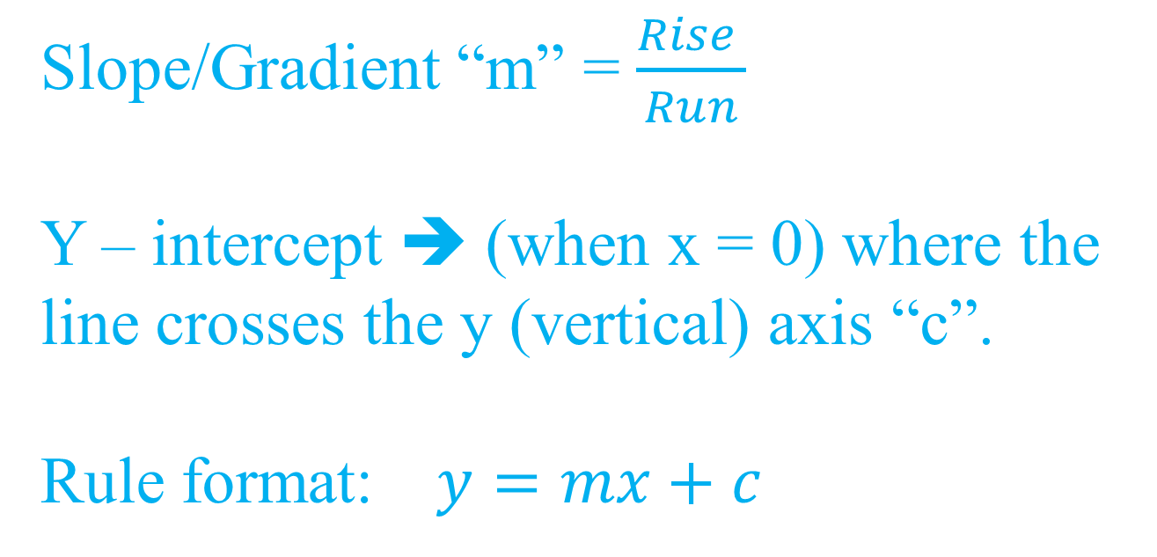
Notes
Slope/Gradient “m” = $\frac{Rise }{Run}$
Y – intercept ➔ (when x = 0) where the line crosses the y (vertical) axis “c”.
Rule format: $y=mx+c$

Slide 5
Finding m and c
y
8
Find the Value of c
This is the point at which the line crosses the y-axis.
7
6
5
4
3
So c = 3
2
Find the Value of m The gradient means the rate at which the line is climbing.
Each time the lines moves 1 place to the right, it climbs up by 2 places.
1
x
–7 –6 –5 –4 –3 –2 –1
1 2 3 4 5 6 7 8
⁻1
⁻2
⁻3
⁻4
y = 2x +3
y = mx +c
⁻5
So m = 2
⁻6
Back to Main Page

Slide 6
Finding m and c
y
8
Find the Value of c
This is the point at which the line crosses the y-axis.
7
6
5
y = 2x +3
y = mx +c
4
So c = 2
3
2
Find the Value of m The gradient means the rate at which the line is climbing.
Each time the line moves 1 place to the right, it moves down by 1 place.
1
x
–7 –6 –5 –4 –3 –2 –1
1 2 3 4 5 6 7 8
⁻1
⁻2
⁻3
⁻4
⁻5
So m = -1
⁻6
Back to Main Page

Slide 7
Some Lines to Identify
y
Line 1
m =
c =
Equation:
8
1
7
2
6
5
y = x + 2
4
Line 2
m =
c =
Equation:
3
1
2
1
-1
x
y = x - 1
–7 –6 –5 –4 –3 –2 –1
1 2 3 4 5 6 7 8
⁻1
⁻2
Line 3
m =
c =
Equation:
⁻3
-2
⁻4
1
⁻5
y = -2x + 1
⁻6
Back to Main Page

Slide 8
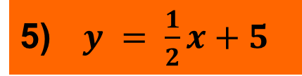
Exercise
y
5
Click for Answers
8
3
1) y = x - 2
7
6
2) y = -x + 3
5
4
3) y = 2x + 2
3
2
4) y = -2x - 1
1
x
$y = \frac{1}{2}x+5$
–7 –6 –5 –4 –3 –2 –1
1 2 3 4 5 6 7 8
⁻1
⁻2
⁻3
⁻4
2
1
⁻5
⁻6
4
Back to Main Page

Slide 9
The Table Method
We can use an equation of a line to plot a graph by substituting values of x into it.
Example
y = 2x + 1
x = 0 y = 2(0) +1 y = 1
x | 0 | 1 | 2
y | 1 | 3 | 5
x = 1 y = 2(1) +1 y = 3
x = 2 y = 2(2) +1 y = 5
Now you just have to plot the points on to a graph!
Back to Main Page

Slide 10
The Table Method
x | 0 | 1 | 2
y
4
3
1
3
5
2
1
-4
-3
-2
-1
0
1
2
3
4
-1
-2
y = 2x + 1
-3
-4
Back to Main Page

Slide 11
The Table Method: whiteboards
Draw the table of values and complete for each function of x:
1) y = x + 3
2) y = 2x – 3
3) y = 2 – x
4) y = 3 – 2x
x | 0 | 1 | 2
y
Click to reveal plotted lines
Back to Main Page

Slide 12
Plotting on a graph
By using a table of values, we create coordinates that follow the function. By plotting these coordinates, we create our linear graph.

Slide 13
Plotting Line Graphs
x | -2 | -1 | 0 | 1 | 2
y
0
1
2
3
4
For the line y = x + 2
When x = -2
y = -2 + 2
y = 0
When x = -1
y = -1 + 2
y = 1
When x = 0
y = 0 + 2
y = 2

Slide 14
Plotting Line Graphs
x | -2 | -1 | 0 | 1 | 2
y
Co-ordinates
0
1
2
3
4
(-2, 0)
(-1, 1)
(0, 2)
(1, 3)
(2, 4)
Now we have some co-ordinates, we can plot them to draw the line!

Slide 15
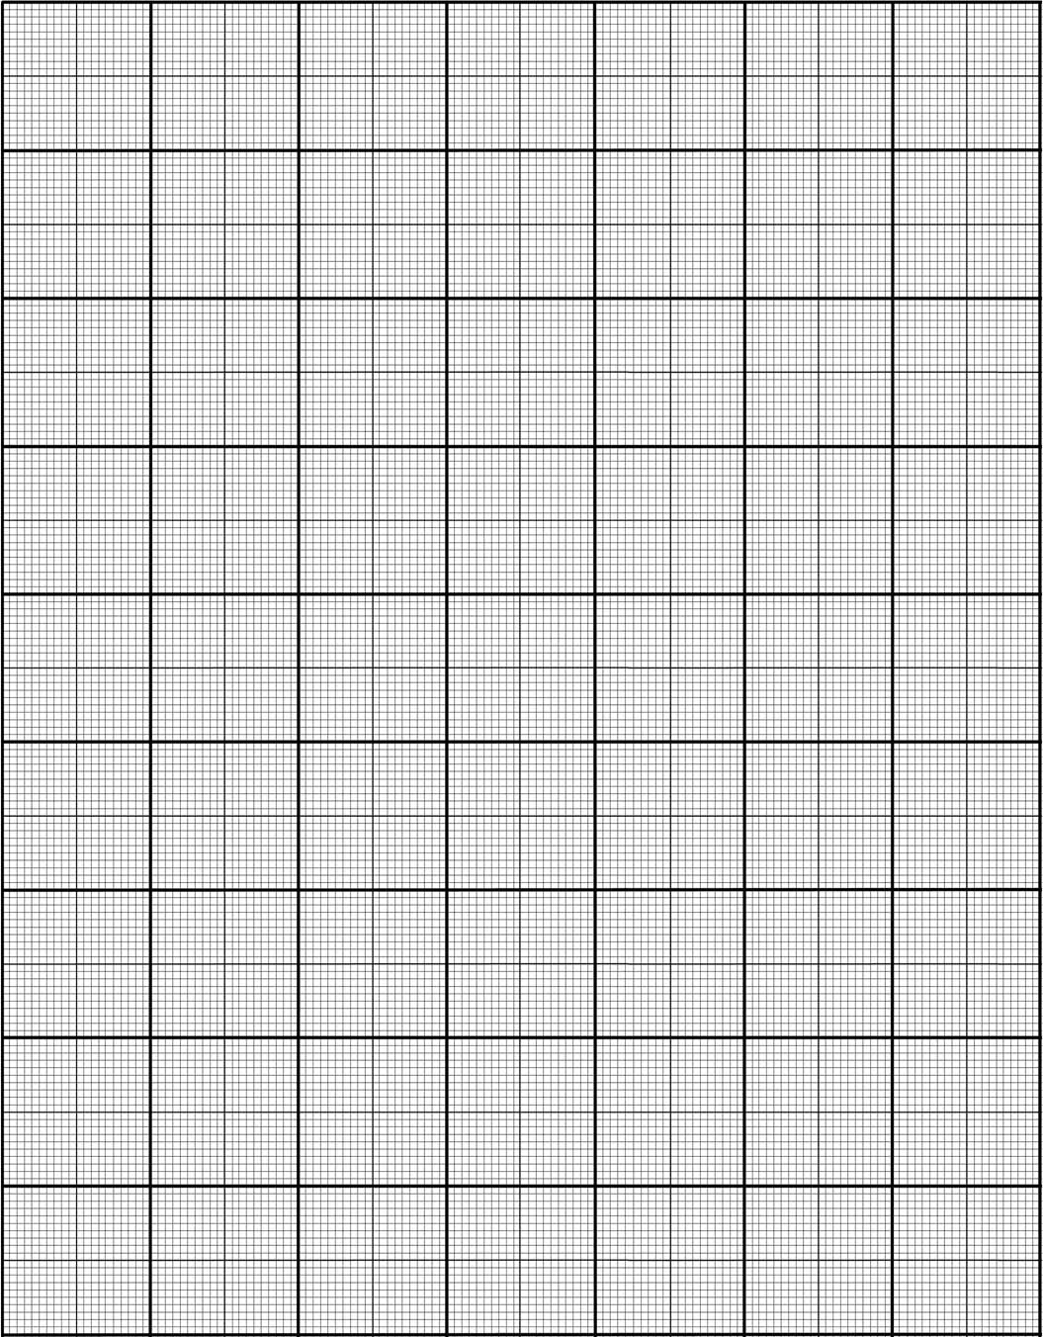
y
y = x + 2
5
4
X
3
X
X
x | -2 | -1 | 0 | 1 | 2
y
Co-ordinates
2
0
1
2
3
4
X
1
(-2, 0)
(-1, 1)
(0, 2)
(1, 3)
(2, 4)
X
X
-5
-4
-3
-2
-1
0
1
2
3
4
5
-1
-2
-3
-4
-5

Slide 16
Individual practice
Continue with yesterday’s graphing
Write your rules**

